Slide 1
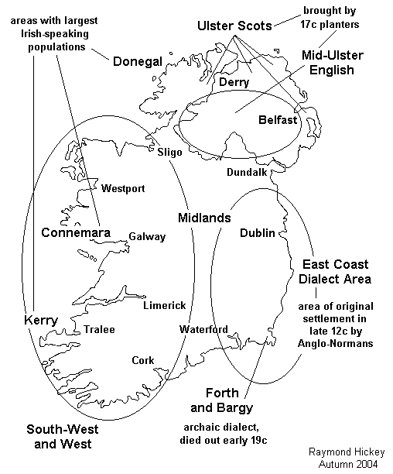
How the Irish speak English:
Python Machine Learning for Classification of English-language Accents in Ireland
Peter Nolan
databeaker@gmail.com
https://github.com/dpnolan/voxpop
PyCon Ireland, Saturday 16 November 2024

Slide 2
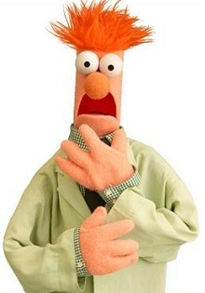
About Me
Born and raised... where?
databeaker@gmail.com

Slide 3
About Me
Born and raised in south county Dublin
Not quite a data scientist, and certainly I'm no linguist either, but the Python ecosystem allowed me to do this project
Background: TCD B.B.S. Business
I wrote a neural network model by hand in C to predict stock indices and FX rates for my thesis. Although we observed predictive power as measured in the then-current computer science literature, the models fell apart under the cost assumptions and statistical tests from finance. One major trading house I worked at had switched off their neural net in early 1996
London City University / Bayes Business School - Mathematical Finance M.Sc.
National College of Ireland M.Sc. Data Analysis this year
Python provides a free and community-supported workshop of tools, both general (NumPy, Pandas, TensorFlow) and specialised (librosa) that match those used in the research literature, enabling projects such as this
databeaker@gmail.com

Slide 4
How the Irish speak English: Summary
Irish people speak English with distinctive sounds in speech: What do these sounds tell us about social identity?
From existing academic and open-source datasets of speech samples of Irish people speaking English ("Irish English" linguists call this) from locations all over both the Republic of Ireland and Northern Ireland, I have selected one that I hope is large enough (1500+ speakers, 266 in my target classes) and with enough geographic variation for computational data analysis, namely the Sound Atlas of Irish English by Prof. Raymond Hickey (2004).
Linguistic research in Ireland has worked with recordings since before 1900, but research patterns manually, the researcher listens to the recordings to detect patterns, which can be slow and subjective. Automation through computational data analysis is promising.
My research project is the first attempt at machine learning using the SAIE dataset out of 179 previous citations, and the first for any machine learning for regional variation in Ireland.
I build models to classify voice samples by location using the speaker's age, gender and speech features. Using logistic regression, random forests, MLP and CNN neural networks, I achieve significant performance (accuracy > 85%, AUC > 90%) in classification, compared to claimed state of the art of 90-95% in the research literature.
Based on this, I propose a new Sound Atlas of Irish English, an all-island crowd-sourced effort to gather a large, open-source, up to date dataset to build public understanding, for linguistics research and for engineering better automated speech processing

Slide 5
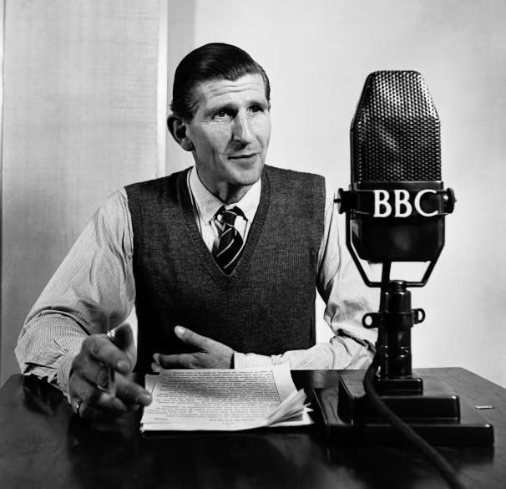
What is an accent?
In common usage, an accent is a ‘way of pronouncing a language that is distinctive to a country, area, social class, or individual’, according to the Oxford English Dictionary
Social hierachy can enforce accent conformity, as with 'BBC English'.
Dialect is understood differently by linguists as a distinctive grammar and vocabulary
Accent instead refers to the identifiable differences in pronunciation of the words and sentences among a group (Hughes et al. 2012, chapter 1).
Accent model is the classification not on matching the individual, instead capturing characteristics of the whole group through the estimation process
Distinctive patterns remain beyond individual variations, which can be observed in the stops and starts, the tones used, letters pronounced or the words and grammar.
Data leakage is a significant risk, the training and test datasets need to have different speakers, otherwise you are identifying each the speaker
We detect accents manually all the time, but can automated speech processing?
What does this tell us about the speaker's identity, individual or group characteristics e.g. personal identification, gender, age, income, geographic origin, national origin, religious?

Slide 6
Motivation
Why study accent?
Accent is DATA, and automated speech processing will perform badly or encode discrimination if done poorly or without accountability. Speech processing services from Amazon and Google perform worse on Northern Irish accents than any other UK or Dublin data (Markl 2022). Two Stanford students from Singapore report inferior performance for that English accent also (Sheng & Edmund 2017).
Accent is IDENTITY It impacts how we understand ourselves and our changing society and how others treat us, sometimes maliciously, as shown in Northern Ireland and Yugoslavia.

Slide 7
Historical Background
How the Irish speak English?
Almost all people in Ireland, north and south, have English as their first language at home, school and work since 1900, but there are wide variations in vocabulary and pronunciation
Influence of Irish is felt, which was progressively abandoned in a pattern beginning in the east, then moving west
Historical migration patterns of Normans, Welsh, Scots-Ulster, English and trade flows were important, in Dublin especially
Movements after Cromwell, the Famine, then urbanisation
Media - broadcast and now online - show different pronunciations, including English and American
Distinctive patterns remain beyond individual variations? What does this tell us? How predictable is this?

Slide 8

Irish Culture Focuses on Irish Speech
Literature, Comedy and Satire
Joyce - especially in Portrait of the Artist as a Young Man, when the narrator argued with a schoolmaster, reproduced the voices of the Irish as a product of their conflict over identity
"How different are the words home, Christ, ale, master, on his lips and on mine!"
The Irish speech pattern is a linguistic way of subverting a political conquest, wrote the critic Seamus Deane

Slide 9
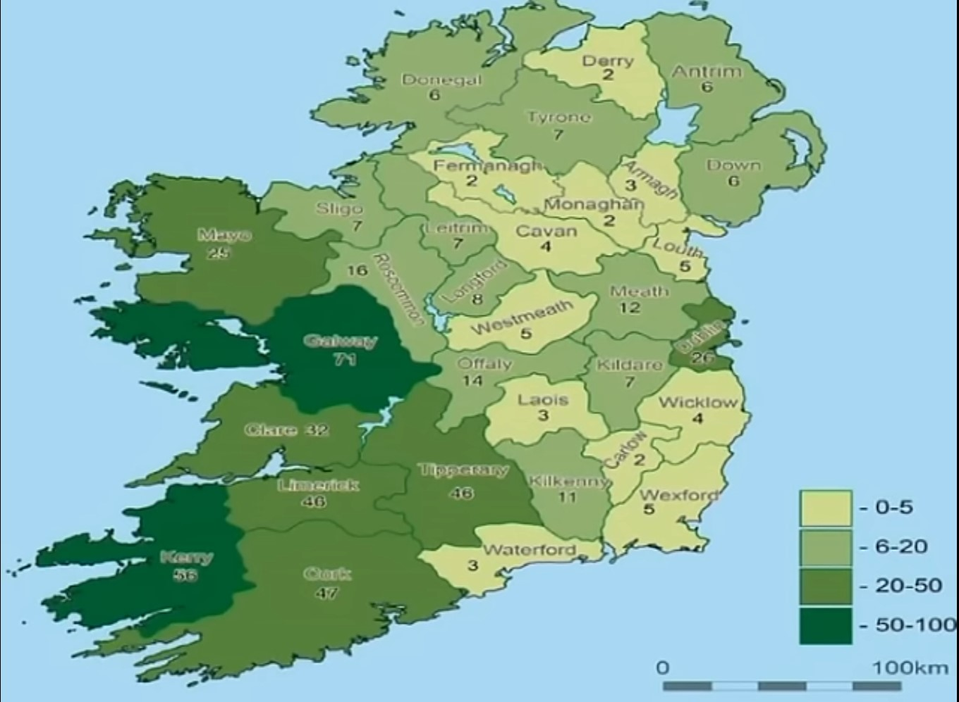
Irish Culture Focuses on Irish Speech
Literature, Comedy and Satire
Niall Tóibín: A Guide to the Regional Accents of Ireland
https://www.youtube.com/watch?v=EhLdKJnY194
Identifies and demonstrates the most common accents

Slide 10
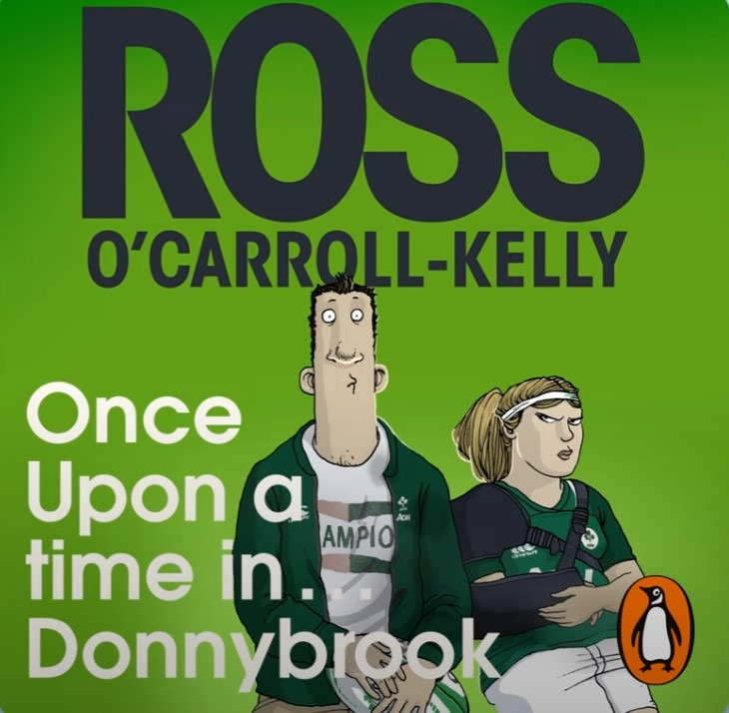
Irish Culture Focuses on Irish Speech
Literature, Comedy and Satire
Ross O’Carroll-Kelly, a stereotypical affluent south Dublin rugby-player, has given a name to the `DORT’ accent, named after the 'DART' commuter rail
From just one of his audiobooks over the past 25 years as a bestseller:
https://youtu.be/vlobTz-9_Fc?t=40

Slide 11
Research Question
How can we classify some selected regional accents in Ireland using data analysis techniques based on the features within the sound of their speech and on demographic characteristics of the speakers? Leads to three questions in sequence.
What datasets can support this computational data analysis?
What features, which may be either the sound recording data or features calculated from it, or personal characteristics, will be useful inputs to the classification model predicting which region the model comes from?
What data analysis models will perform this classification well?

Slide 12

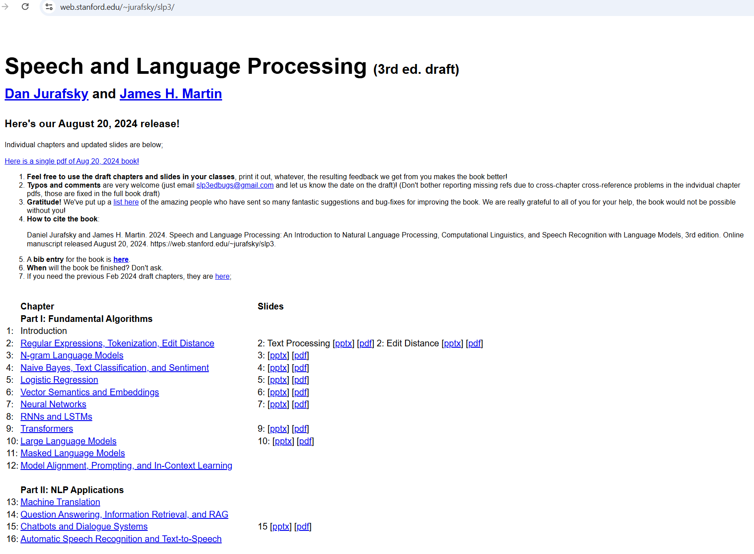
Literature Review
Sheng & Edmund in their 2017 Stanford thesis, which is the highest ranked result from Google searches for 'machine learning' 'accent classification'. They build classification models with English language speech data alone with different accents and getting increasingly good performance as they move from using decision trees, then multi-layer perceptrons and then convolutional neural networks for accuracy over 85 to classify samples into three Asian accents in spoken English https://cs229.stanford.edu/proj2017/final-reports/5244230.pdf
Until around 2006, automated speech processing was largely separate from neural network and deep-learning research domain, Hidden Markov Models dominated.
Deep learning models began outperforming in speech processing once more layers, different architectures and improved optimisation algorithms became available e.g. Maas et al. (2017) and (Lesnichaia et al. 2022) showed that more hidden layers, random initialisation of network weights, newer optimisers and Dropout pruning all have improved deep learning classification performance on accent classification.
After 2012, based on Hinton's and Bengio's work on unsupervised learning using layers of autoencoders to label samples, architectures increasingly use the sound recording directly as input.
A recent INTERSPEECH paper Zuluaga-Gomez et al. (2023) which uses variants of the wav2vec2 models using wavenet, transformer and masking models, cross-training on non-English language data produces the highest classification accuracy of any of these examples at over 97%.
Geron (2022) surveys the evolution of deep learning including audio processing; Jurafsky and Martin 'Speech and Language Processing' 3e (forthcoming) is free online.

Slide 13
Candidate Datasets of Irish English
Speech Accent Archive (SAA) - Commonly-used in the literature but has only 17 Ireland or Northern Ireland samples (https://accent.gmu.edu/)
International Corpus of English (http://ice-corpora.net/ice/) data was not available and the admins were unresponsive
Oxford Linguistics Lab - Intonational Variation in English (IViE) has Dublin and Belfast samples, but just 6 speakers recorded in each location (http://www.phon.ox.ac.uk/files/apps/IViE/)
Mozilla CommonVoice - crowd-sourced data including thousands of samples, labelled by gender, age and country, including from Ireland, but no more detailed geodata (https://commonvoice.mozilla.org/en)

Slide 14
Sound Atlas of Irish English (‘SAIE’)
Book and dataset by Raymond Hickey (2004)
Prof. Linguistics at Uni. Limerick and Uni. Essen - Duisberg
www.raymondhickey.com
Recordings done in public places have scripted samples repeated from over 1,500 speakers
Date range from 1980 onwards
Come from all 32 counties, rural and urban areas, speakers across Ireland
Anonymously gathered, but with age, gender and location data captured
Cited in Google Scholar about 179 times as of today, but the book and the research citing it is all based on human ear to listen, detect features and classification, not any computational data analysis

Slide 15
A Model to Answer the Research Question
What accent is detected on a speech sample?
y, the target, or dependent, variable is a geographic location within Ireland
Inputs may be speech recording data and features derived from it
Personal characteristics - age, gender and other values may be available
Candidate models will be classification with different models and different choices of variables,
Largely will be a supervised learning task
I follow much the same methodology as Sheng and Edmund 2017 here in using multiple models

Slide 16




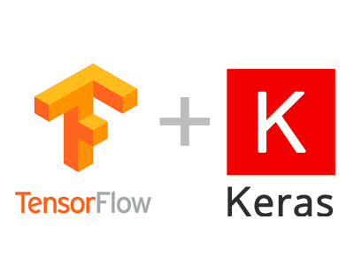

Models from Python Libraries
Speech processing and feature extraction and graphing from librosa
Logistic regression - using scikit-learn
Random forests - using scikit-learn
Neural network - MLP using Tensor Flow Keras
Convolutional Neural Network - Using Tensor Flow Keras
Classification metrics scikit-learn

Slide 17
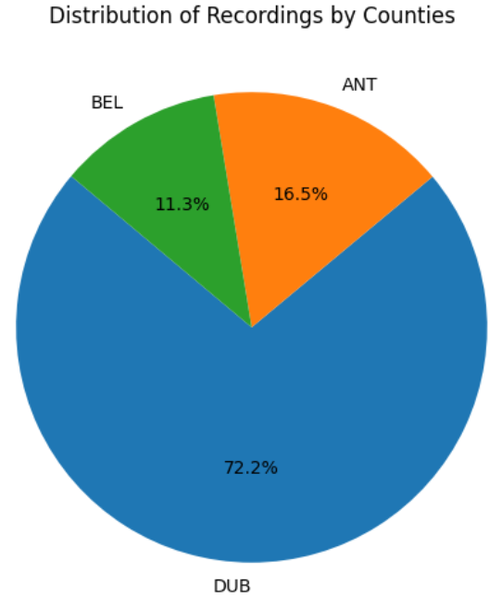
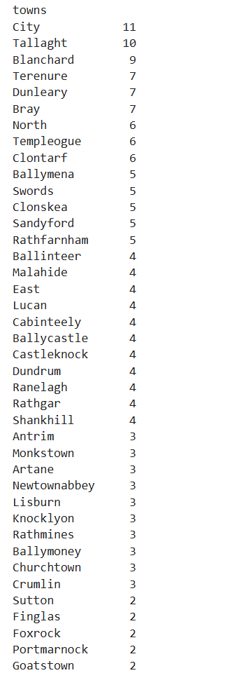
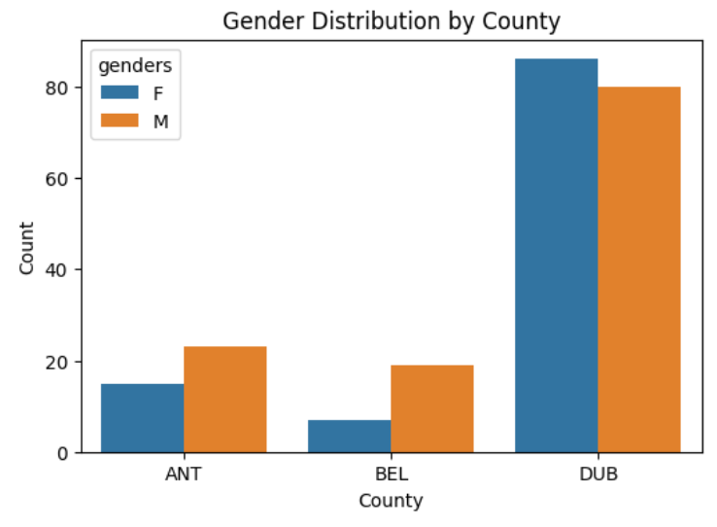
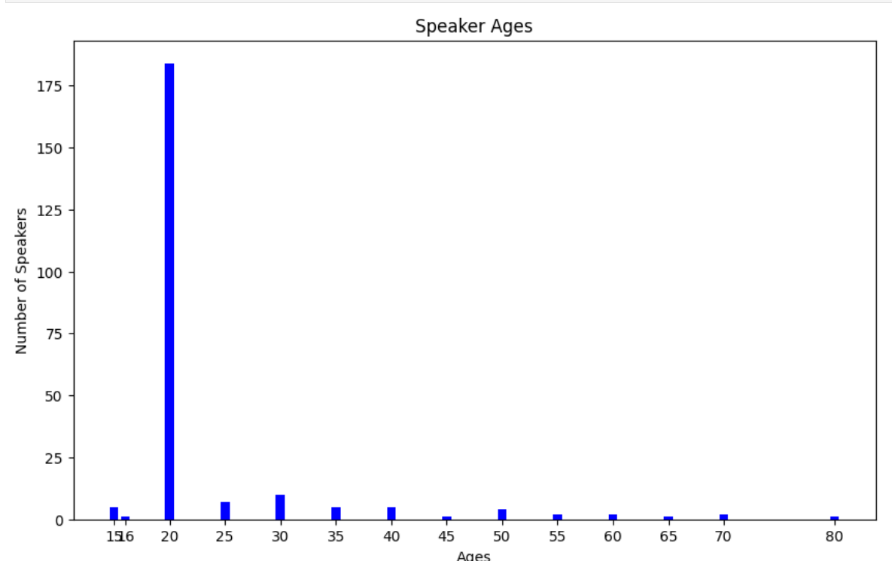
Exploratory Data Analysis
Imbalanced dataset by County
122 male and 108 female speakers imbalanced in ANT+BEL
Most speakers 'around' 20 years of age
Speakers are not very concentrated in particular districts of Dublin
Biggest category in Belfast dataset is 'city', while no category for the west, the traditional centre for Irish Catholic / Nationalist / Republican communities

Slide 18
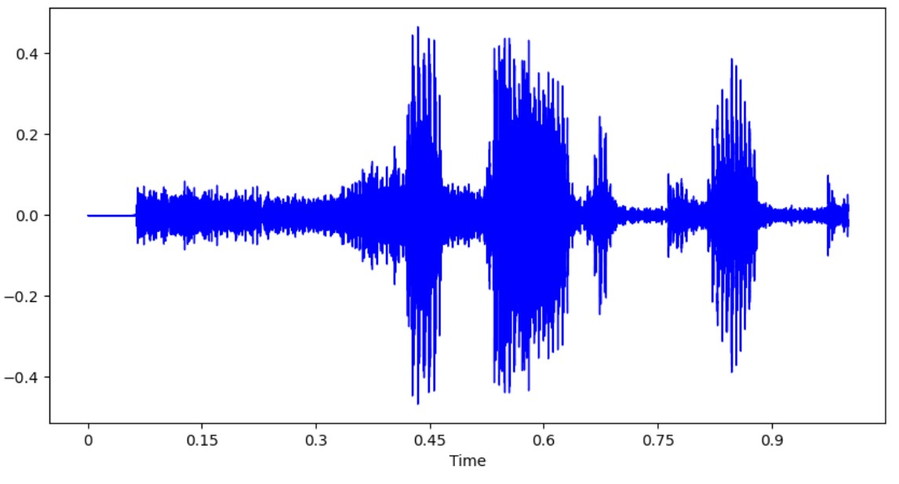
Preprocessing - Extract Data and Features
.wav sound files as the source data from Hickey, the book having a CD with sound files, visualisation files and Java code, but nothing like the open-source libraries that Python has
Each file has one speaker repeating scripted standard sentences
librosa library used for this, the most common in the research literature
Jupyter notebook per county dataset, here Antrim/Belfast (ANT) and Dublin city and county (DUB)
Detect the length of the sound file in seconds
Check if the file is wav, as some are mislabelled and are really .mp3 and if so, convert to .wav
Filenames encode the metadata e.g.DUB_Artane_M_20_(2).wav here, shows county Dublin ('DUB' or 'ANT' or 'BEL'), unstructured town or suburb name, gender code ('M' or 'F'), age range code and a count
The metadata for each file is extracted to a Pandas DataFrame along with the raw sound data
Sample data is sound wave value against time, graphed here for 1 second

Slide 19
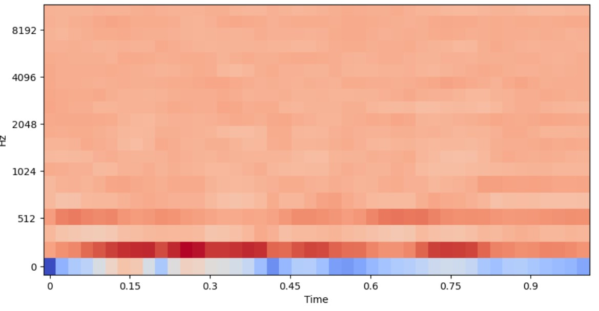
Preprocessing - Calculate Sound Features
From the sound recording, librosa is used to calculate a Mel Frequency Cepstrum Coefficients (MFCC), commonly used in telecoms, seismic and speech data analysis
MFCC is calculated using a linear cosine transform of a log power spectrum on a nonlinear mel scale of frequency.
x-axis = time
y-axis = the frequency in Hz on a mel scale, a log scale that matches human sound perception
hue = power, the original x value squared

Slide 20
Estimates - Data
Each speaker recording is split into samples of 1 second, literature shows ranges from 0.5 to 4 seconds
MFCC for 20 sub-periods are calculated, the librosa default value, so around 50 milliseconds each
Accent classification for the Belfast or Dublin datasets, binary variable (0/1) as Y variable
Age and gender as categorical X variables
From the speech sample, the MFCC, MFCC delta (lagged values) and MFCC delta 2 (lagged two periods) are numerical X variables
The risk exists that the difference may be from recording equipment used generating distinctive sounds
Forward-stepwise estimation - start with simple models, then add more variables and see if the performance improves

Slide 21
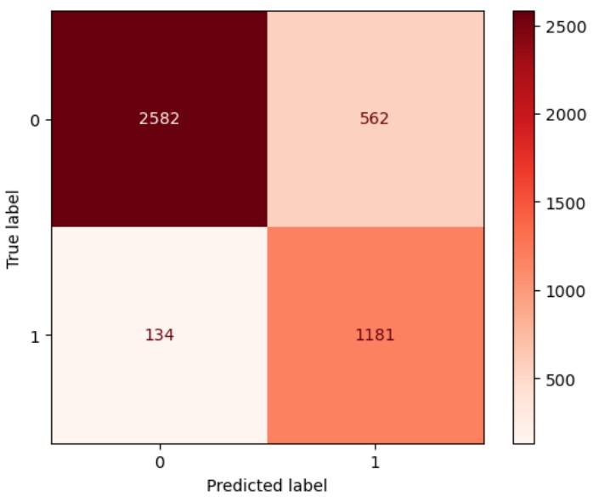
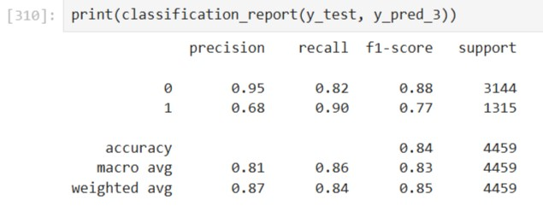
Classification Metrics
Classification metrics calculations come from scikit-learn library also
Note that the two classes are imbalanced, significantly different from equal numbers, so the adjustment is needed in the model estimation e.g. lr3 = LogisticRegression(...class_weight='balanced')
Confusion Matrix - a table that categorises predictions as True or False by output, shown for log reg model 2, X = MFCC True Negative = True Positive = False Negative = False Positive =
classification_report gives summary statistics e.g. Accuracy = TN + TP / (TN+TP+FN+FP) =

Slide 22
Classification Metrics
Classification metrics calculations come from scikit-learn library also
Note that the two classes are imbalanced, significantly different from equal numbers, so the adjustment is needed in the model estimation e.g. lr3 = LogisticRegression(...class_weight='balanced')
Confusion Matrix - a table that categorises predictions as True or False by output, shown for log reg model 2, X = MFCC True Negative = 2582 True Positive = 1181 False Negative = 134 False Positive = 562
classification_report gives summary statistics e.g. Accuracy = TN + TP / (TN+TP+FN+FP) = 84.4%
Precision, Recall, F1 are calculated also - whether they are useful depends on the cost or effect of an error

Slide 23
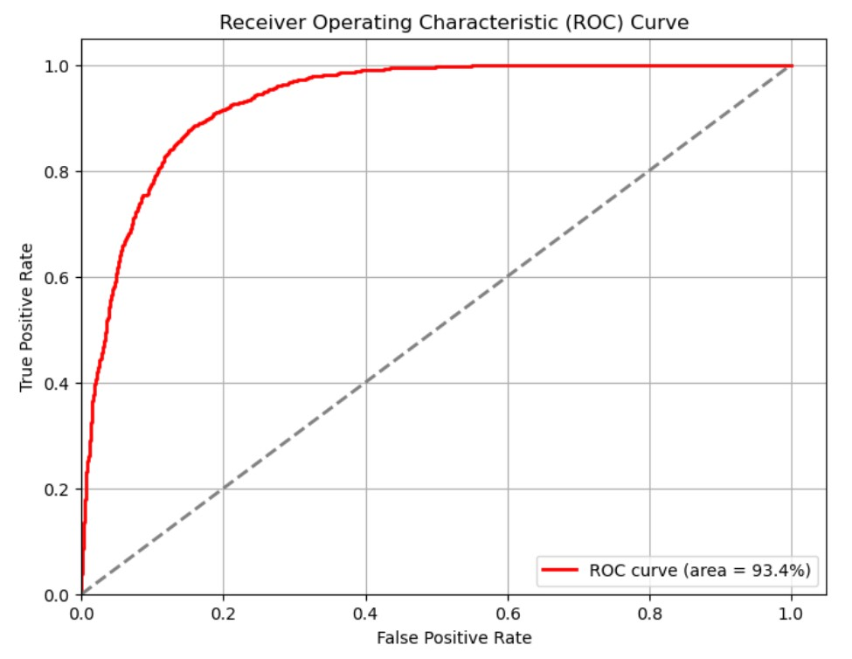
Classification Metrics
The ROC evaluates classification model peformance
Predictions are sorted by the model's estimated probability of the positive class, with the largest values first.
Beginning at the origin, each prediction moves the curve vertically for a correct classification or horizontally for an incorrect one.
The area under the ROC curve ('AUC') usually scales from a minimum 0.5 up to 1 for perfect prediction for all examples.

Slide 24
Logistic Regression
Logistic regression estimates the probability that that one observation belongs to one of the two classes.
Accent classification has Belfast or Dublin binary categorical variable (0/1) as Y variable
MFCC features are the numerical X-variables, age and gender as categorical X variables
Forward-stepwise evolution of the datasets - I run the logistic regression models, with different combinations of X variables i.e. (2) gender and age alone (3) MFCC alone (4) MFCC plus gender and age (5) then MFCC_delta with gender and age (6) MFCC_delta_2 with age and gender (7) All MFCC features, age and gender
MFCC with age and gender was best combination of variables ROC-AUC of 95.3% and accuracy of 88.1%
Model | X | Accuracy | AUC
2 | Gender, Age | 70.8% | 70.7%
3 | MFCC | 84.4% | 93.4%
4 | MFCC, Gender, Age | 88.1% | 95.3%
5 | MFCC_delta, Gender, Age | 71.5% | 75.1%
6 | MFCC_delta_2, Gender, Age | 67.3% | 76.6%
7 | All | 86.6% | 94.7%

Slide 25
Random Forest
Random Forest uses an ensemble of decision tree classifier models, trained on different random subsets of the training dataset. The most popular classification becomes the ensemble prediction.
Accent classification has Belfast or Dublin binary categorical variable (0/1) as Y variable
MFCC features are the numerical X-variables, age and gender as categorical X variables
Forward-stepwise evolution of the datasets - I run the random forest, with combinations of variables as before i.e. (2) gender and age alone (3) MFCC alone (4) MFCC plus gender and age (5) then MFCC_delta with gender and age (6) MFCC_delta_2 with age and gender (7) All MFCC features, age and gender
MFCC with age and gender was best combination of variables ROC-AUC of 95.3% and accuracy of 88.1%
Model | X | Accuracy | AUC
2 | Gender, Age | 66% | 69.7%
3 | MFCC | 84.4% | 93.3%
4 | MFCC, Gender, Age | 86.3% | 94.9%
5 | MFCC_delta, Gender, Age | 74.1% | 76%
6 | MFCC_delta_2, Gender, Age | 71.2% | 73.3%
7 | All | 84.4% | 94.7%

Slide 26
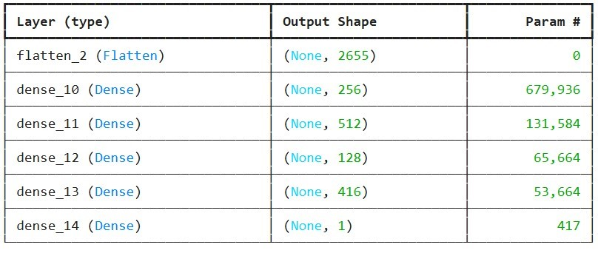
Neural Network MLP
Multi-layer Perceptron architecture
Hyperparameters were selected using the Keras Tuner to choose among values at random from the neuron numbers, learning rate and choice of an extra (fourth) layer
Target, or dependent, variable is a geographic accent location within Ireland
MFCC was fed in as X variable
Age gender were added as one-hot encoded inputs also to X
Test dataset accuracy of 84.3%, AUC 88.4%
Test accuracy 80-88% are typical and ROC AUC of 92%

Slide 27
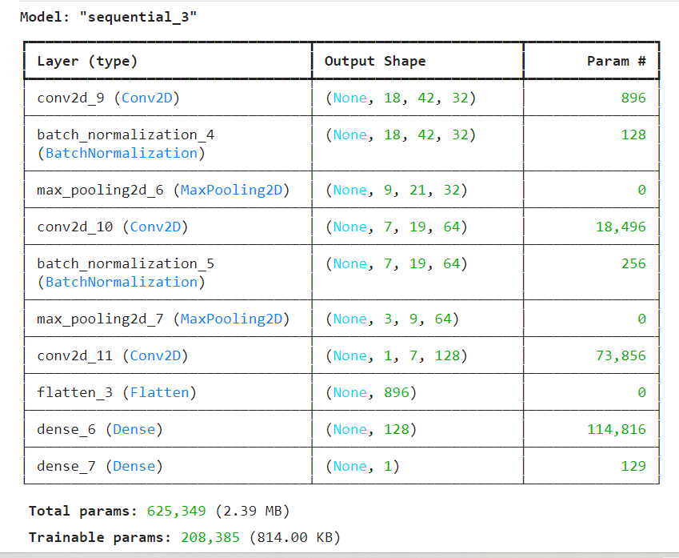
Convolutional Neural Network
Y is the region of the accent
MFCC were fed in as X variable
Test dataset accuracy was 91.84%, AUC of 95.1%
MFCC speech data alone was achieving test accuracy in the 89--92% range.

Slide 28
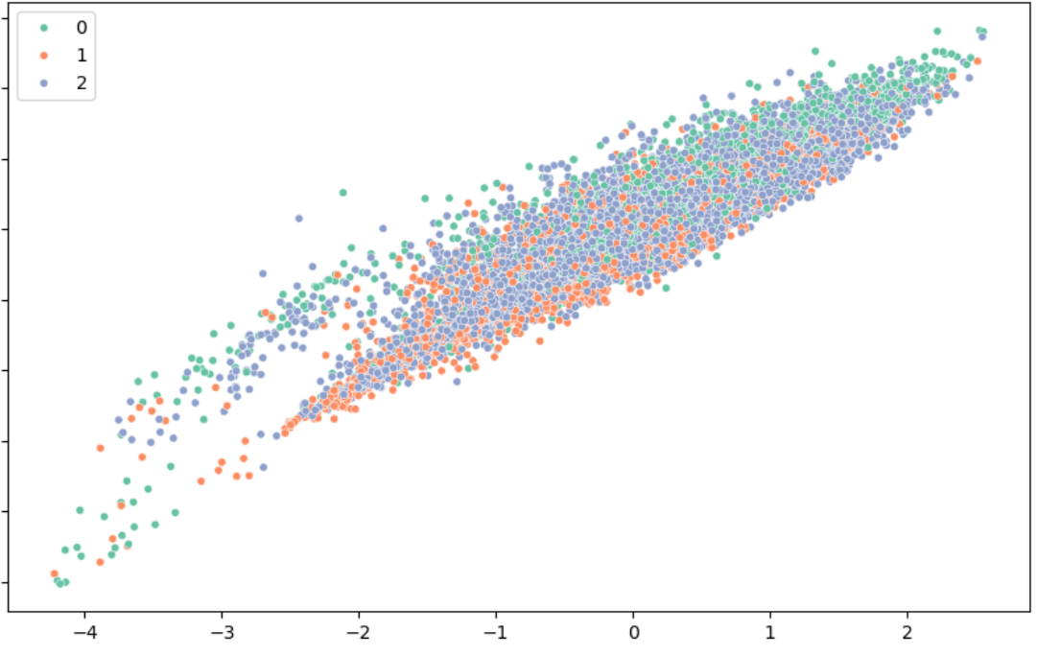
Clustering Analysis
Clustering MFCC, gender and
age with n=2 and n=3 k-means algorithms on the country was tried too
No visible clustering visible on either case or with the same model with MFCC only

Slide 29
Conclusions & Future Research Questions
With logistic regression, speech data from MFCC, on its own and added to personal characteristics give significantly positive classification performance, accuracy of 80-88%.
Random forest models almost matched that.
MLP improved on those results and then CNN more so, up to 92%.
Wide range of more evolved deep-learning models to apply in future research: 'Large Audio Models' claim 90-94% accurate classification, but my LAM examples (not shown here) came nowhere close: investigation continues.
More data, assured data quality, and the ability to create links to other variables are key to more robust estimation and more advanced machine learning models.
What future questions?

Slide 30
Future Research Questions?
More data and better assurance around data quality will are key to more robust estimation from future work
More advanced machine learning models should be adapted and tried
Combining data from other languages, Irish and Scots in particular
Mutli-modal data - add video, social media metrics and consumer behaviour to speech data
Data can be gathered at an institution level, especially secondary schools, which have a catchment area, income level and a religious identity
The ability to create links to other personal, demographic and social variables will need design and consultation of the personal and geographic data to match government and statistical boundaries while preserving privacy
How do accents vary across Dublin city and county? Suburbs, neighbourhoods, streets? What mobility or economic status affects this?
How much variation is there by geography e.g. is a Belfast accent closer to modern Scots English or other Irish English?
How do regional accents in Irish English match with Irish language pronunciation?
Do Dublin and Liverpool match?
Are effects of inward migration seen in the common speech?

Slide 31
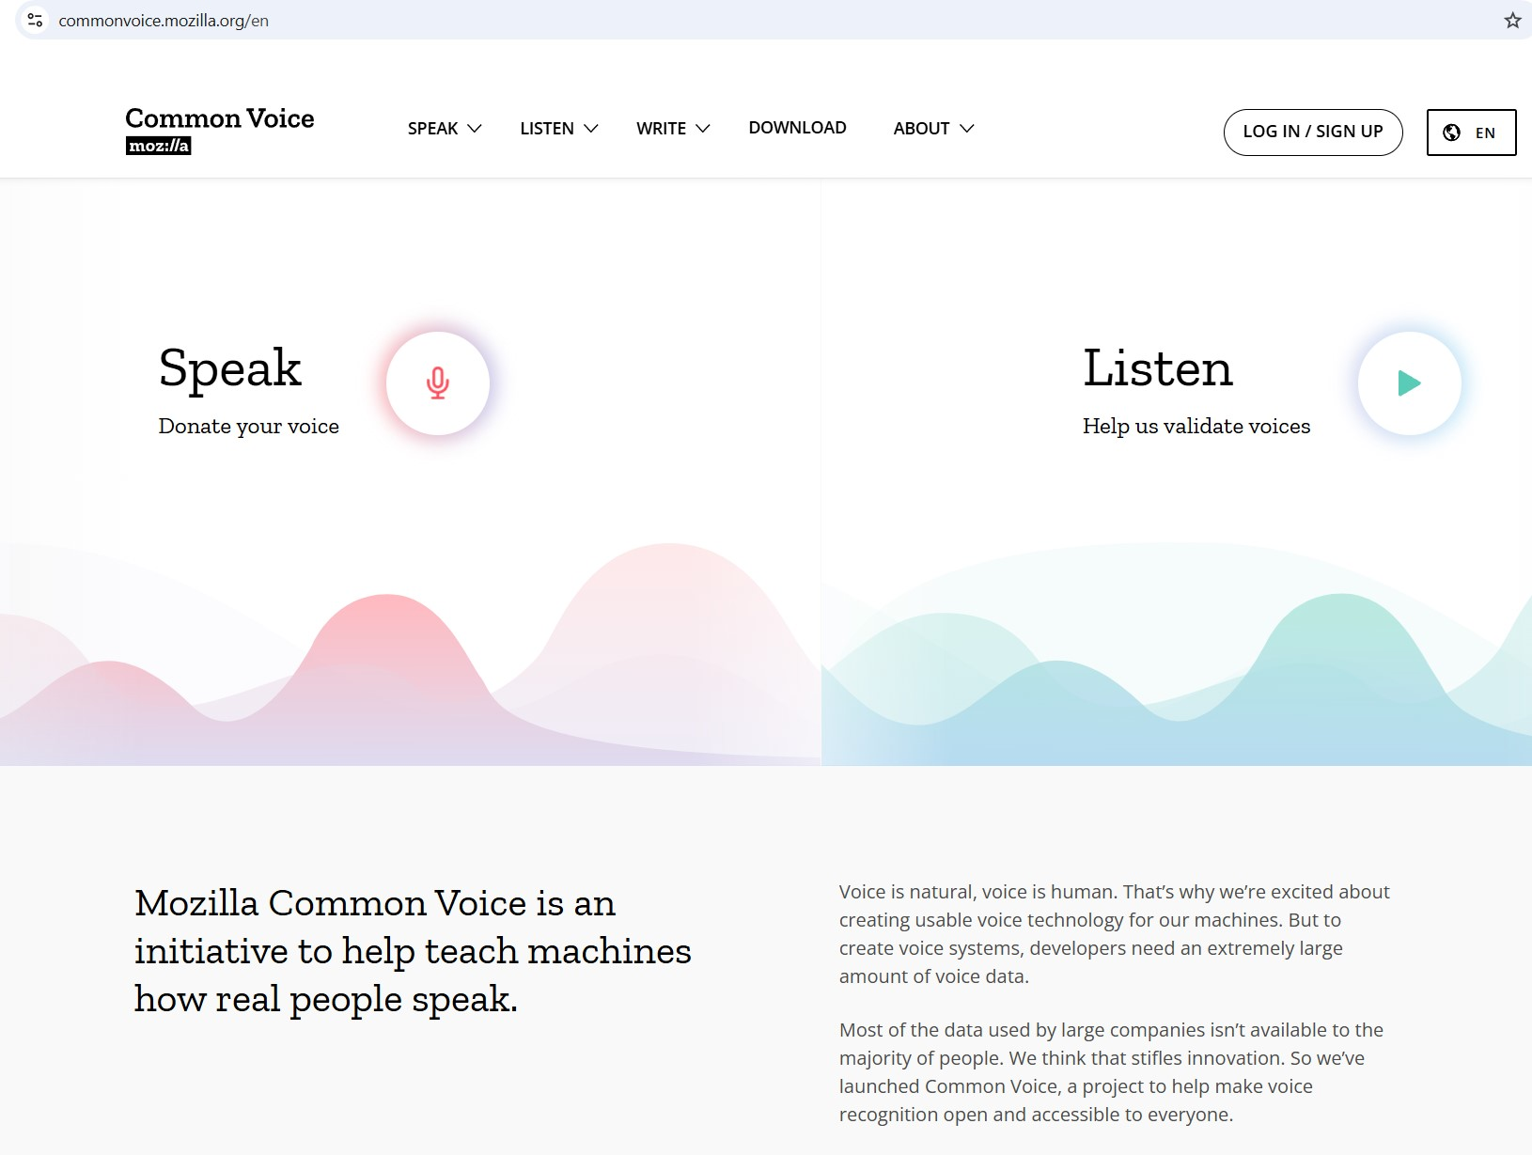
Next Steps - More and Better Data
Crowd-sourcing data online is cheaper and easier than manual collection e.g. http://commonvoice.mozilla.org/en
I am in discussions with Mozilla and Irish universities about creating an academic partnership to do this
CommonVoice Data is labelled by country of origin as Irish, by age and gender, but does not give more detailed geographic or social data
We can add data fields to existing recordings and seek new samples
Email me at databeaker@gmail.com if you would like to participate in future research or data collection

Slide 32

Privacy Implications
Speech samples cover more of the population, as speech processing apps are used more, almost all this is held within the large tech companies, where it may be accessed to your detriment e.g. Saudis and Twitter
Individual identification is no longer secure against impersonation by voice-cloning e.g. https://elevenlabs.io, so spear-phishing fraudsters will impersonate you to make transfers, or tell your relatives that you need money
Network owners or governments can gather and identify speech samples also without users knowing, split the cables in a locked room or hack the data centres and cables between them (Snowden); GCHQ gathers mobile phone signals using planes over British cities (R.Aldrich, 'GCHQ',2019).
Individual identification possible by crossing with other datasets - customer records, social media

Slide 33

Privacy Compliance
Signoff for compliance with Irish data protection legislation
Anonymisation by aggregation, printing only age range, gender county, town and district is mandatory
No personally identifying data should be gathered
No email addresses or IP or other network data published
Subjects should be 18+ years old
Sample contributor conditions specify no sharing or sale of data and legal ownership by a trustee
Users have the contracted right to withdraw consent for use at any time
Record with no name, address, only an email for an individual or institution

Slide 34
How the Irish speak English:
Python Machine Learning for Classification of English-language Accents in Ireland
Peter Nolan
databeaker@gmail.com
https://github.com/dpnolan/voxpop
PyCon Ireland, Saturday 16 November 2024

